Slide 1
The Ashy Bookshelf (aka) United States_LibSyncOS_ME_2000_X_TM
Team 9
Justin Coen Austen Henry
Zach Marcolesco Tricia Schmitz Reagan Wood

Slide 2

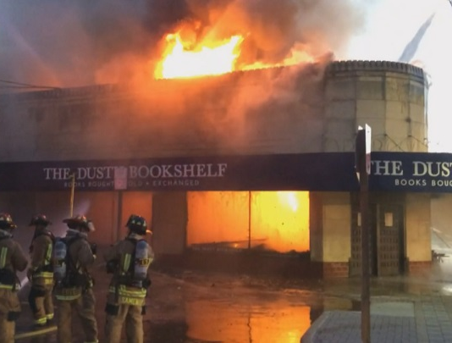
Scenario
A local bookstore has burned down
Bankrupt from the damages, it is converted into a non-profit library
Software development needed

Slide 3
Library System
Has 2 types of users: Customers and Administrators
Stores 2 types of items: Books and Movies
Customers can:
search items by title, genre and people associated with an item
check out and return items
view their account info, including fines, and what items they have checked out
Administrators can:
add fines to a user for an overdue or damaged item
add/delete Items (Book or Movie), Contributors (Actor, Director Author), and Awards for contributors
add/delete new customers

Slide 4
password
damage_fine
available
username
item_id
genre_id
weekly_fine
phone
c_id
title
Item_Genre
Genres
genre
name
due_date
Item_Condition
Cardholders
code
Condit
Items
condit
address
Cardholder_Item
isa
Owes
description
Movies
fine_id
first_name
Peopl_Roles_Items
duration
isa
amount
person_id
studio
Fines
due_date
Books
barcode_no
People
last_name
paid
description
birth_date
Roles
num_pages
Awards_Won
twitter
publisher
death_date
Awards
role_code
role
isbn
award_id
name
year_won

Slide 5
Technical Deets
C# Application
MySQL Database
potential for expansion?
Make use of keys and constraints
Uses transactions to ensure data security

Slide 6
